Slide 1


Control the wheelchair based on the motor imagery and BCI technology
Student name: yuqi He
Student Reg No: 200200170
Supervisor: Dr. Mahnaz Arvaneh

Slide 2

Contents
Background and Motivation
Aims and Objectives
Method
Results
Conclusions

Slide 3
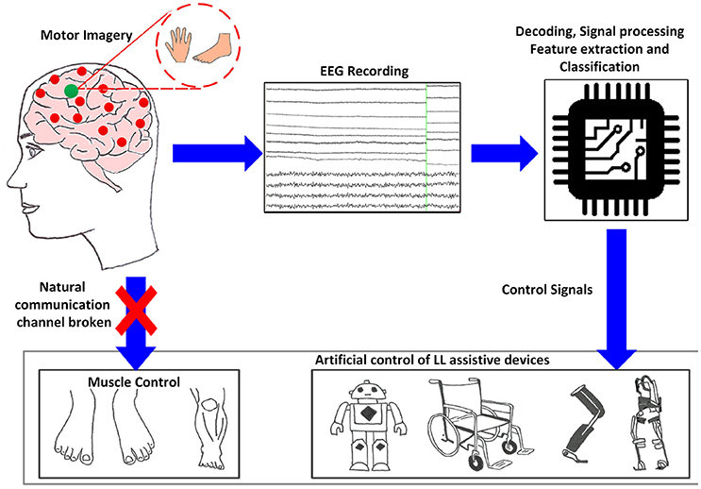
Background
MI-BCI
Related applications of MI-BCI
Figure 1. MI BCI technology principle
Resource：Tariq M, Trivailo PM and Simic M (2018) EEG-Based BCI Control Schemes for Lower-Limb Assistive-Robots

Slide 4
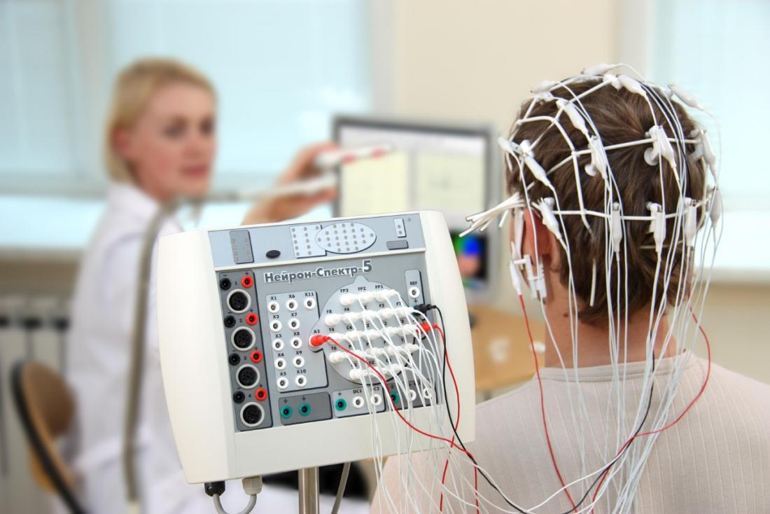
Motivation
Currently MI BCI is mainly applied to 2 classes.
In order to control the smart wheelchair, 4 commands are needed, forward, stop, turn left and right, so a multi-class MI-BCI is needed.
Figure 2. EEG data collection
Resource：Shannon Johnson, 2019

Slide 5
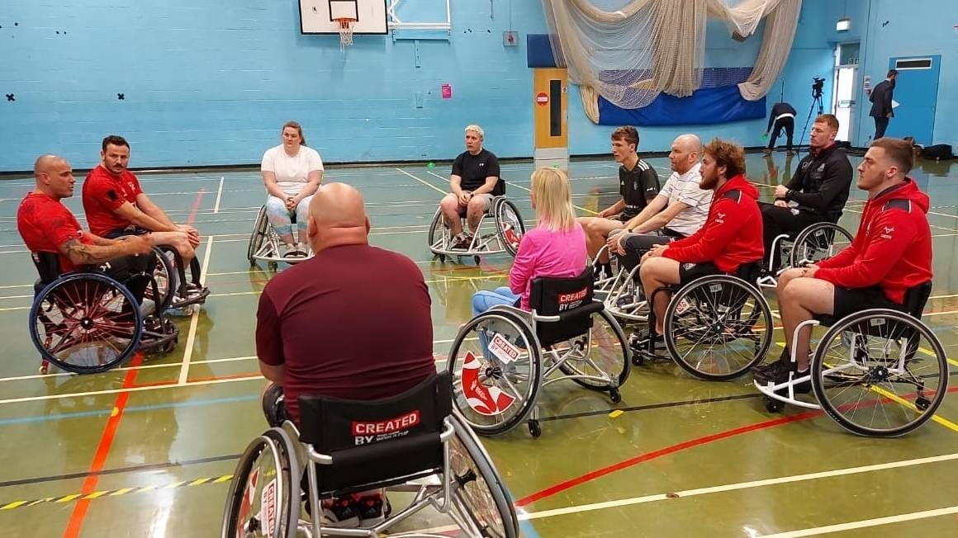
Aims
This design helps those who suffer from diseases or lose the ability to walk due to accidents to sit in a wheelchair, operate the wheelchair through consciousness, and move to the position they want. The wheelchair is controlled by collecting the user's imagination that the fingers of his left and right hands point to different directions or different postures of the arms.
Notes:
More information:
You can crop a picture (trim slices from the side, top or bottom) by selecting on the slide the picture that you want to crop, going to the “format” menu, selecting “picture…” and in the “picture” dialog box clicking the “picture” button. This opens the crop options. The preview button allows you to see whether the crop achieves the effect you wanted. (If you have an old version of PowerPoint these controls may be located differently - refer to the PowerPoint Help menu.)
Before importing a picture into your presentation save it in a suitable format (eg jpeg) at a resolution of 72 dots per inch if possible. This resolution keeps the size of the picture file small but still displays fine on screen – particularly important if you’re using several pictures, because half a dozen taken on a five megapixel digital camera and imported at full resolution could mean that your presentation is over 20 megabytes in size. This means it will take up unnecessary disk space, will be slow to open and run on many less powerful computers – and will be too big to e-mail.

Slide 6
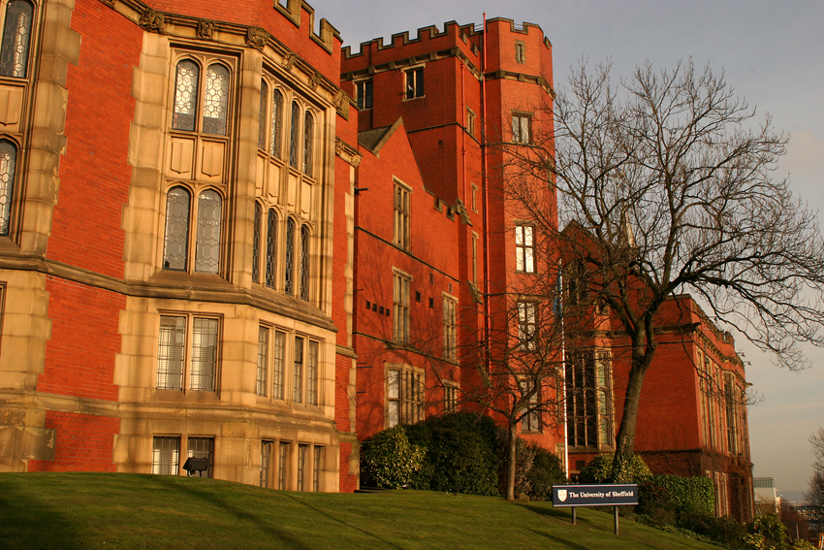
Objectives
Collect highly informative motor imagery data and make classification algorithms through the data collected
Use EEGlab toolbox to process EEG signal data in Matlab
Use the CSP algorithm to extract discriminative features from two different conditioned brain signals—generally
Simple classification of training data using FLDA or SVM
Import the processed data into the model to check whether it can be achieved

Slide 7
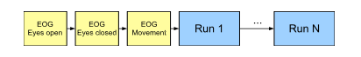
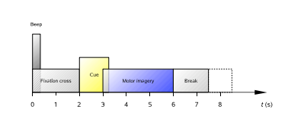
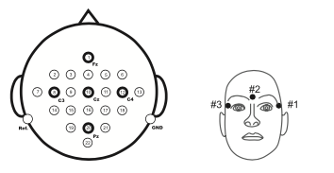
Method
This data collection contains EEG data from nine different people. Four distinct motor imagery assignments were used in the cue-based BCI paradigm.
Before the start of each data collection, in order to exclude the influence of EOG on the data results in the experiment, a relevant eye movement of about 5 minutes was performed and the data was recorded.
Twenty-two electrodes were used to record the EEG; the montage is shown in Figure 5 left
Figure 3. Timing scheme of one session.
Resource：C. Brunner1, R. Leeb1, 2008
Figure 4. Timing scheme of the paradigm.
Resource：C. Brunner1, R. Leeb1, 2008
Figure 5. Left: Electrode montage corresponding to the international 10-20 system. Right: Electrode montage of the three monopolar EOG channels.

Slide 8
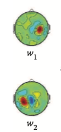
Common Spatial Pattern
Band pass filter : 8-30HZ
The Common Spatial Pattern (CSP) algorithm is effective in constructing optimal spatial filters that discriminates 2 classes of electroencephalogram (EEG) measurements in MI-BCI.
2-class CSP is the state-of-art algorithm.
Figure 6. display two sensorimotor CSP patterns (one for each class)
Notes:
More information
Double clicking the graph opens its source datasheet. To find out how to create a chart look up “create a chart” in the PowerPoint Help menu.

Slide 9
Challenge
Multi-class
Proposing two solutions
OVR-CSP
PW-CSP

Slide 10
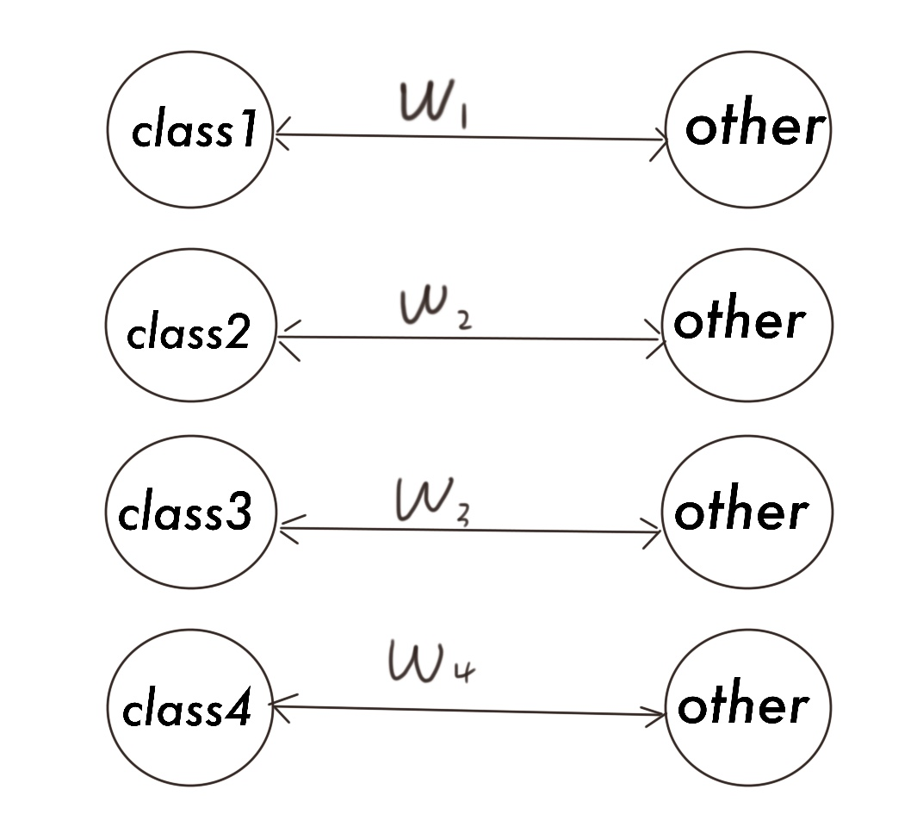
OVR-CSP
The OVR approach computes the CSP features that discriminate each class from the rest of the classes.
A total of four classes of problems have been transformed into four binary classification problems.
Figure 7. The diagram of solving the four classes by OVR-CSP

Slide 11
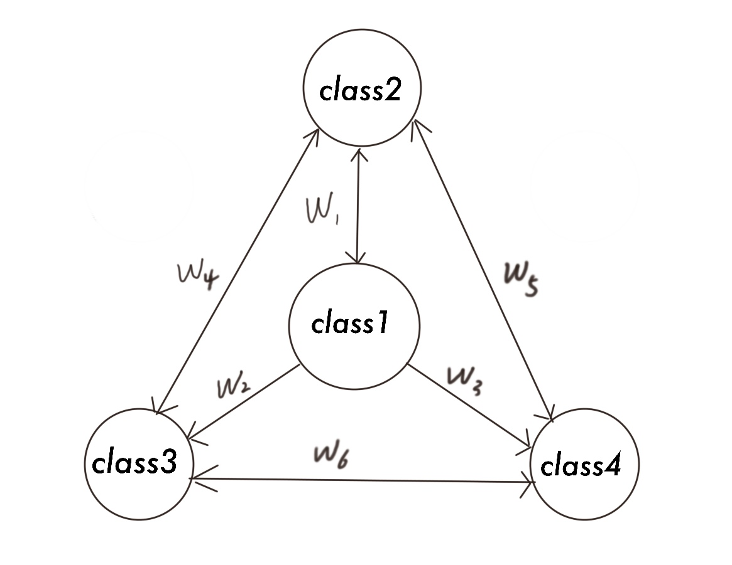
PW-CSP
The Pair-Wise (PW) approach computes the CSP features that discriminate every pair of classes.
The approach generates six spatial filters in total. The signal is delivered to the classifier after passing through six spatial filters to create 12 feature vectors.
Figure 8. The diagram of solving the four classes by PW-CSP

Slide 12
Result
OVR-CSP
16 features
The chance level is 25% because we have four classes.
Analysis of accuracy
Figure 9. The result of OVR-CSP

Slide 13
Result
PW-CSP
24 features
the chance level is 25% because we have four classes
Analysis of accuracy
Figure 10. The result of PW-CSP

Slide 14
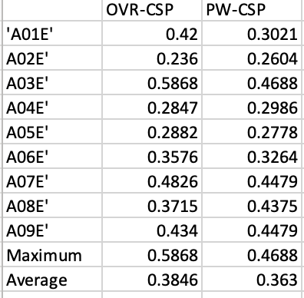
Comparison
Maximum accuracy
Average accuracy
Figure 11. The result of the comparison

Slide 15
Conclusion and Future Work
After comparing the average accuracy of the two CSP algorithms, it is found that the results of the two algorithms are not too different.
In the process of performing the two algorithms, The OVR-CSP algorithm generates 16 features and the PW-CSP algorithm generates 24 features. Given the small training size, these big numbers of features would lead to deteriorated classification results due overfitting. Thus, in future, a feature selection algorithm can be added to improve the classification accuracy by selecting more discriminative features.

Slide 16
Thank you for watching

